Slide 1

AI TEAM
E-SHOP APP MANUAL
22 February 2023

Slide 2

E-Shop App
Contents
E SHOP APP MANUAL
1. Login
2. Generalized Navigation & Browsing
3. Info Pages
4. Navigation Through the Pages
5. Available Actions and How To
AI TEAM

Slide 3

Hello, dear User of E-Shop App!

Slide 4




Login

Slide 5
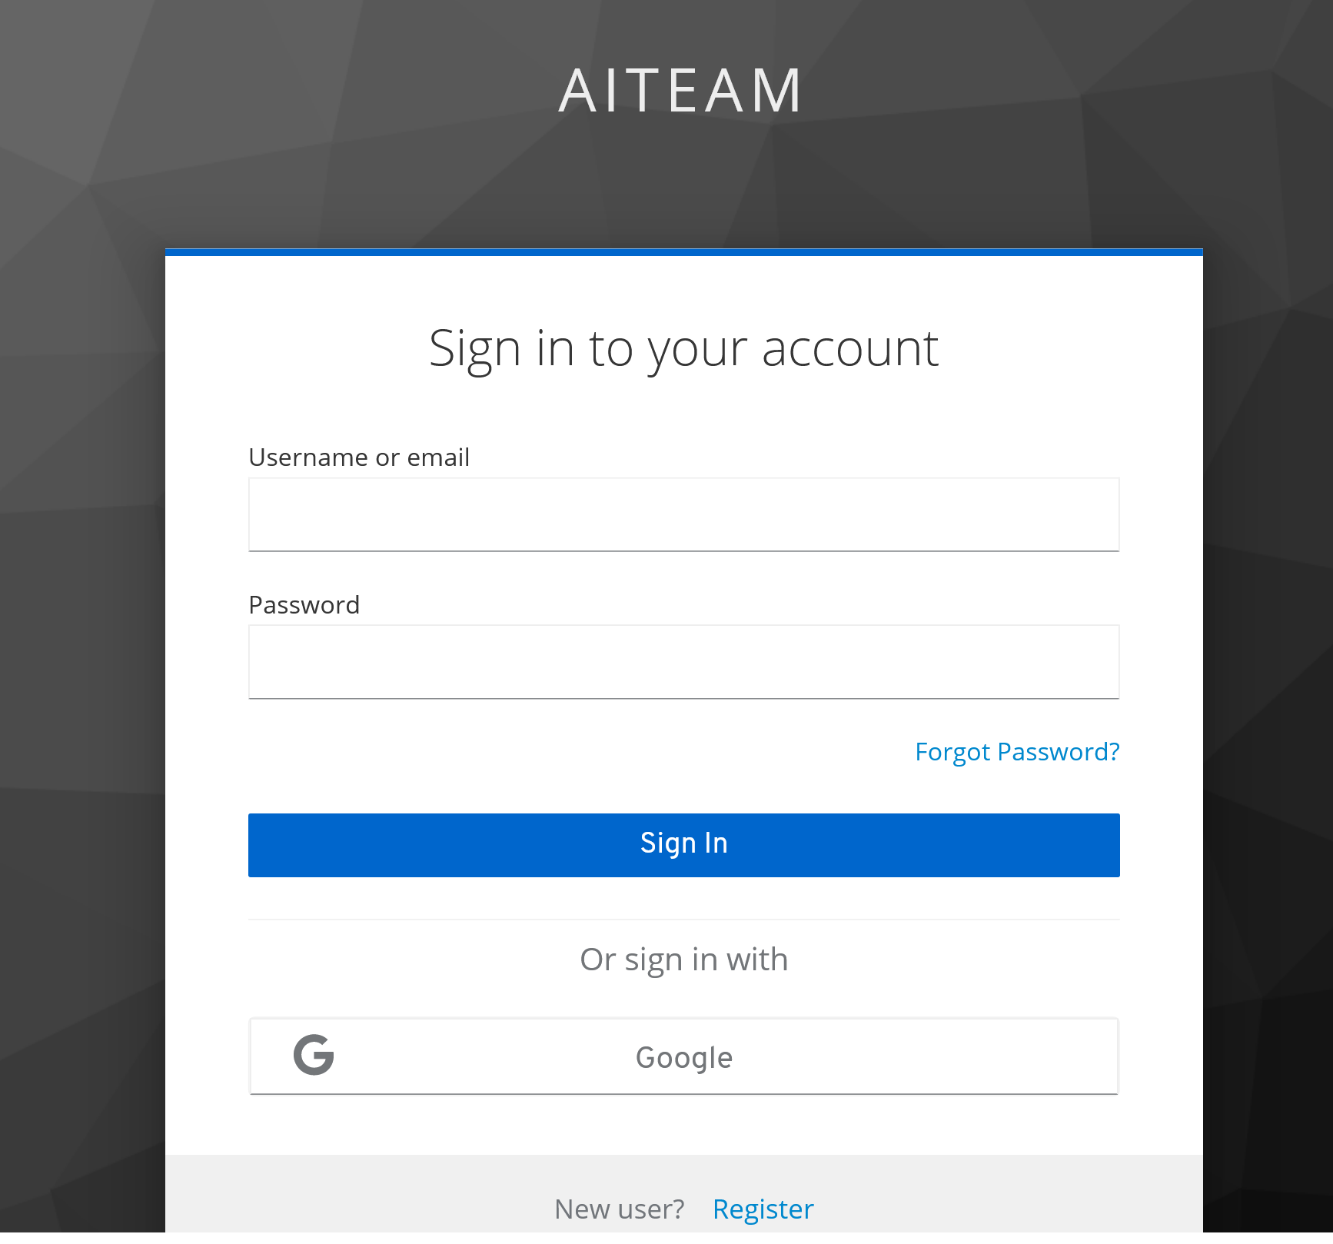
LOGIN
01
LOGIN TO OUR APP!
Access our app on localhost:3000
02
ADD CREDENCIALS
Add username and password and then click “Sign in”! You can Sign In via your Google Account, too!
03
REGISTER
First time on our App? Click “Register”!!

Slide 6
Generalized Navigation & Browsing

Slide 7
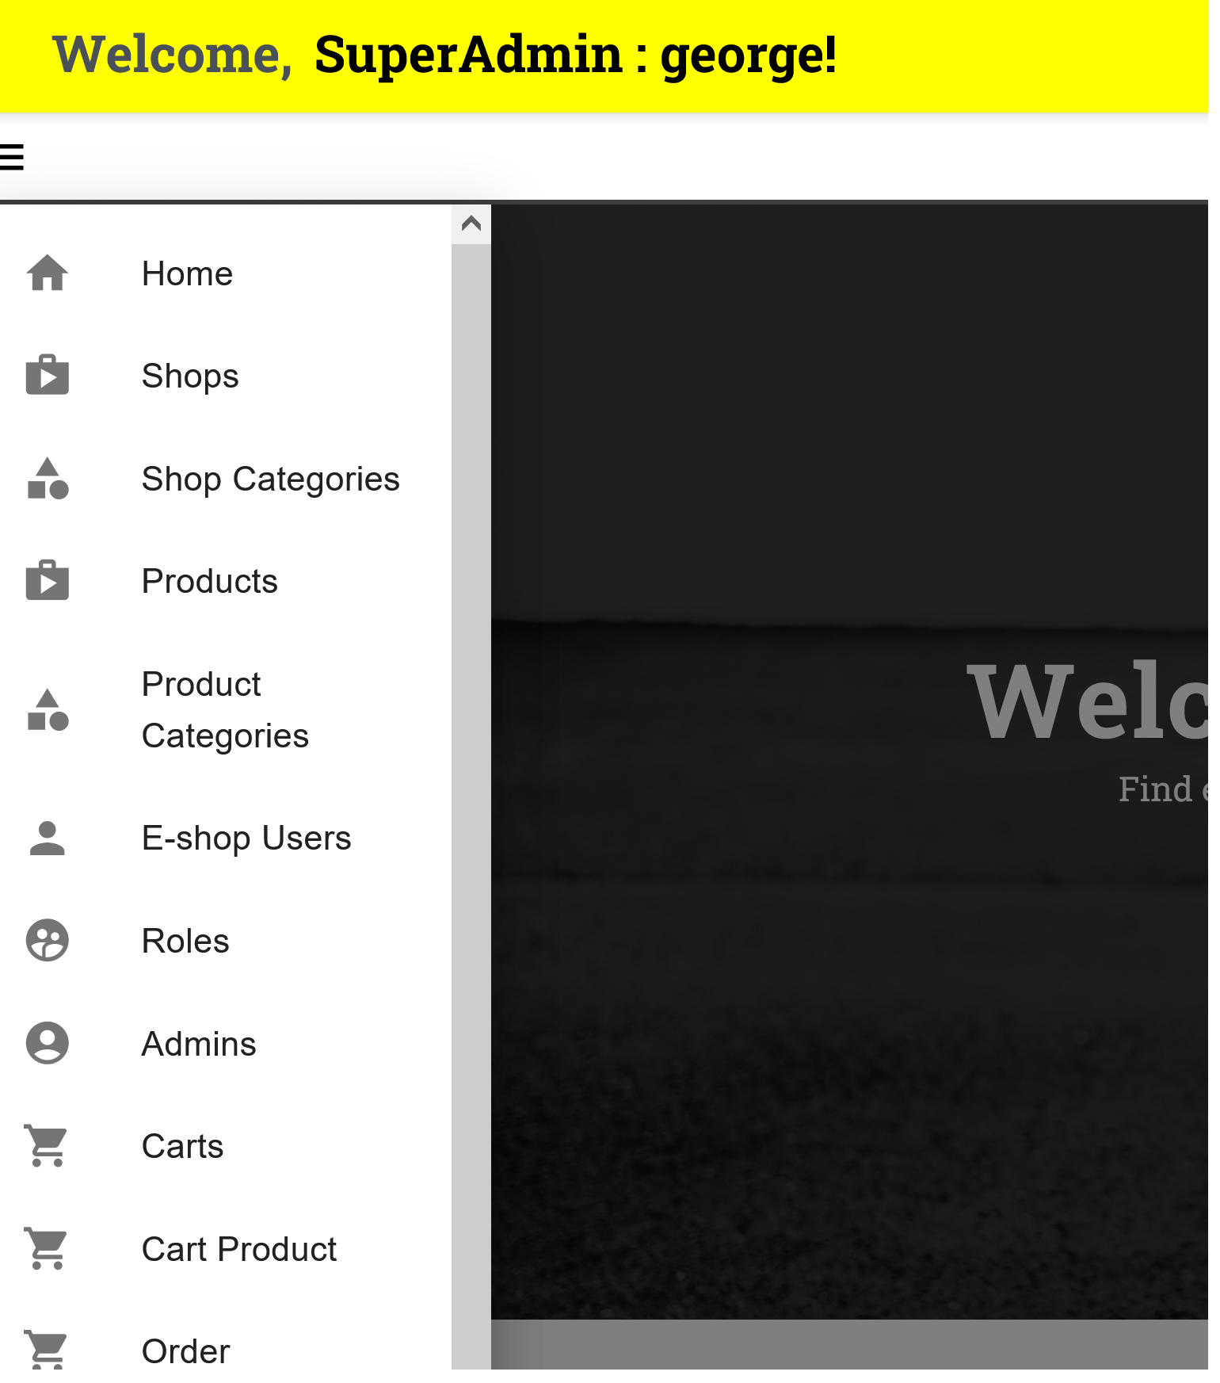
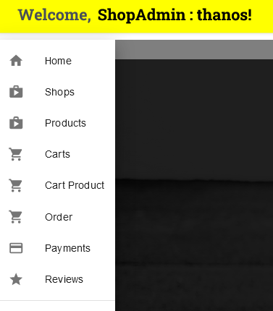
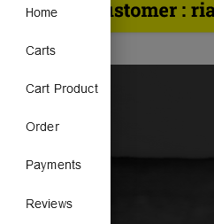
GENERALIZED NAVIGATION AND BROWSING
The 3 Roles of Our App and Left Menus
01
02
03
SUPER ADMIN
SHOP ADMIN
CUSTOMER
Super Admin’s Left Menu.
Shop Admin’s Left Menu.
Customer’s Left Menu.

Slide 8
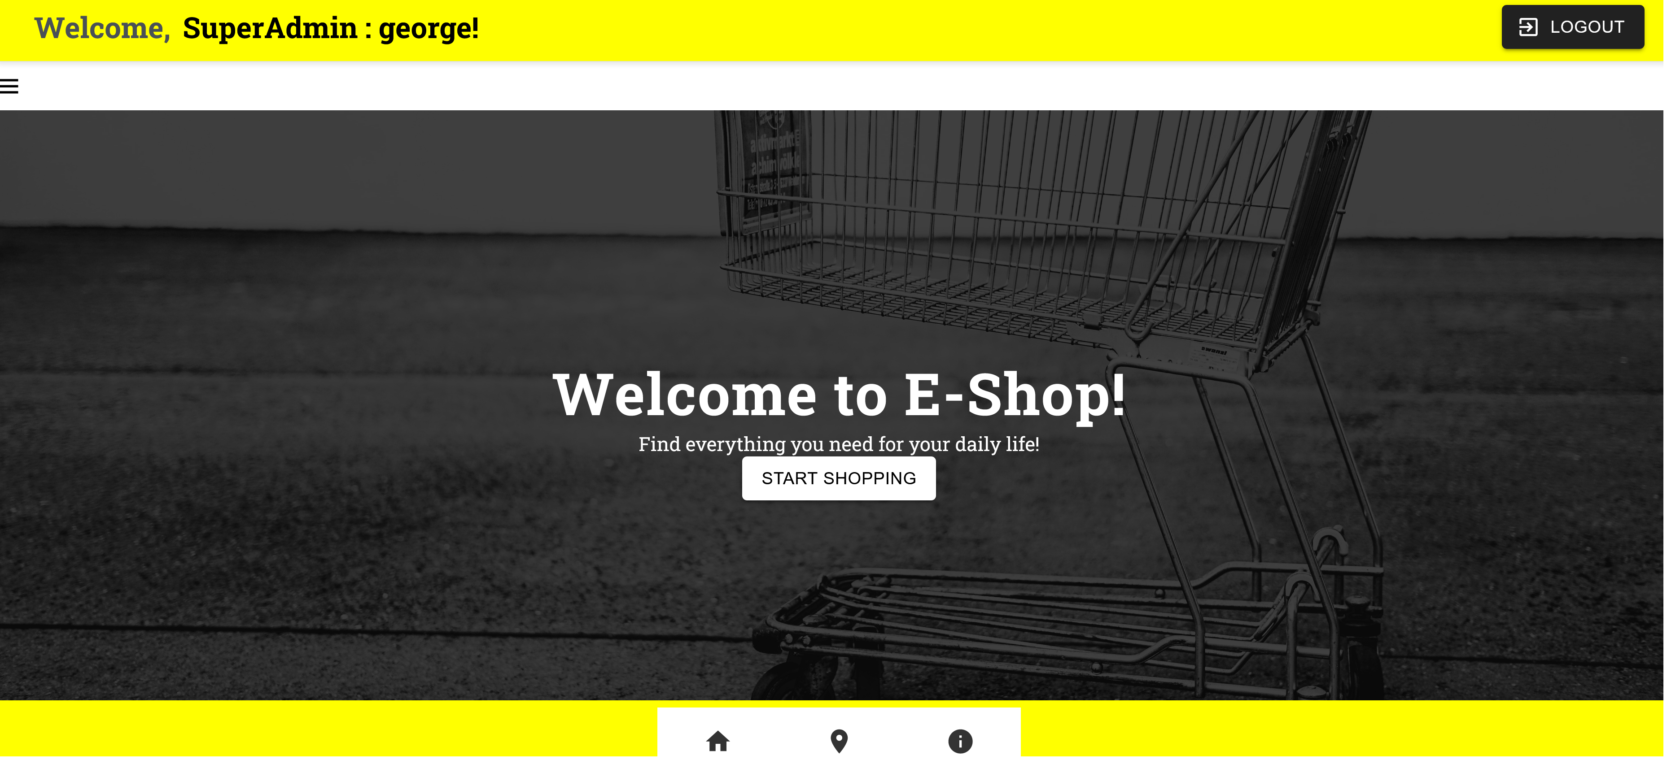
GENERALIZED NAVIGATION AND BROWSING
HOME PAGE
The Left Menu Bar!!
Here to Logout!!
Click Here to Start Shopping!

Slide 9
Info Pages

Slide 10
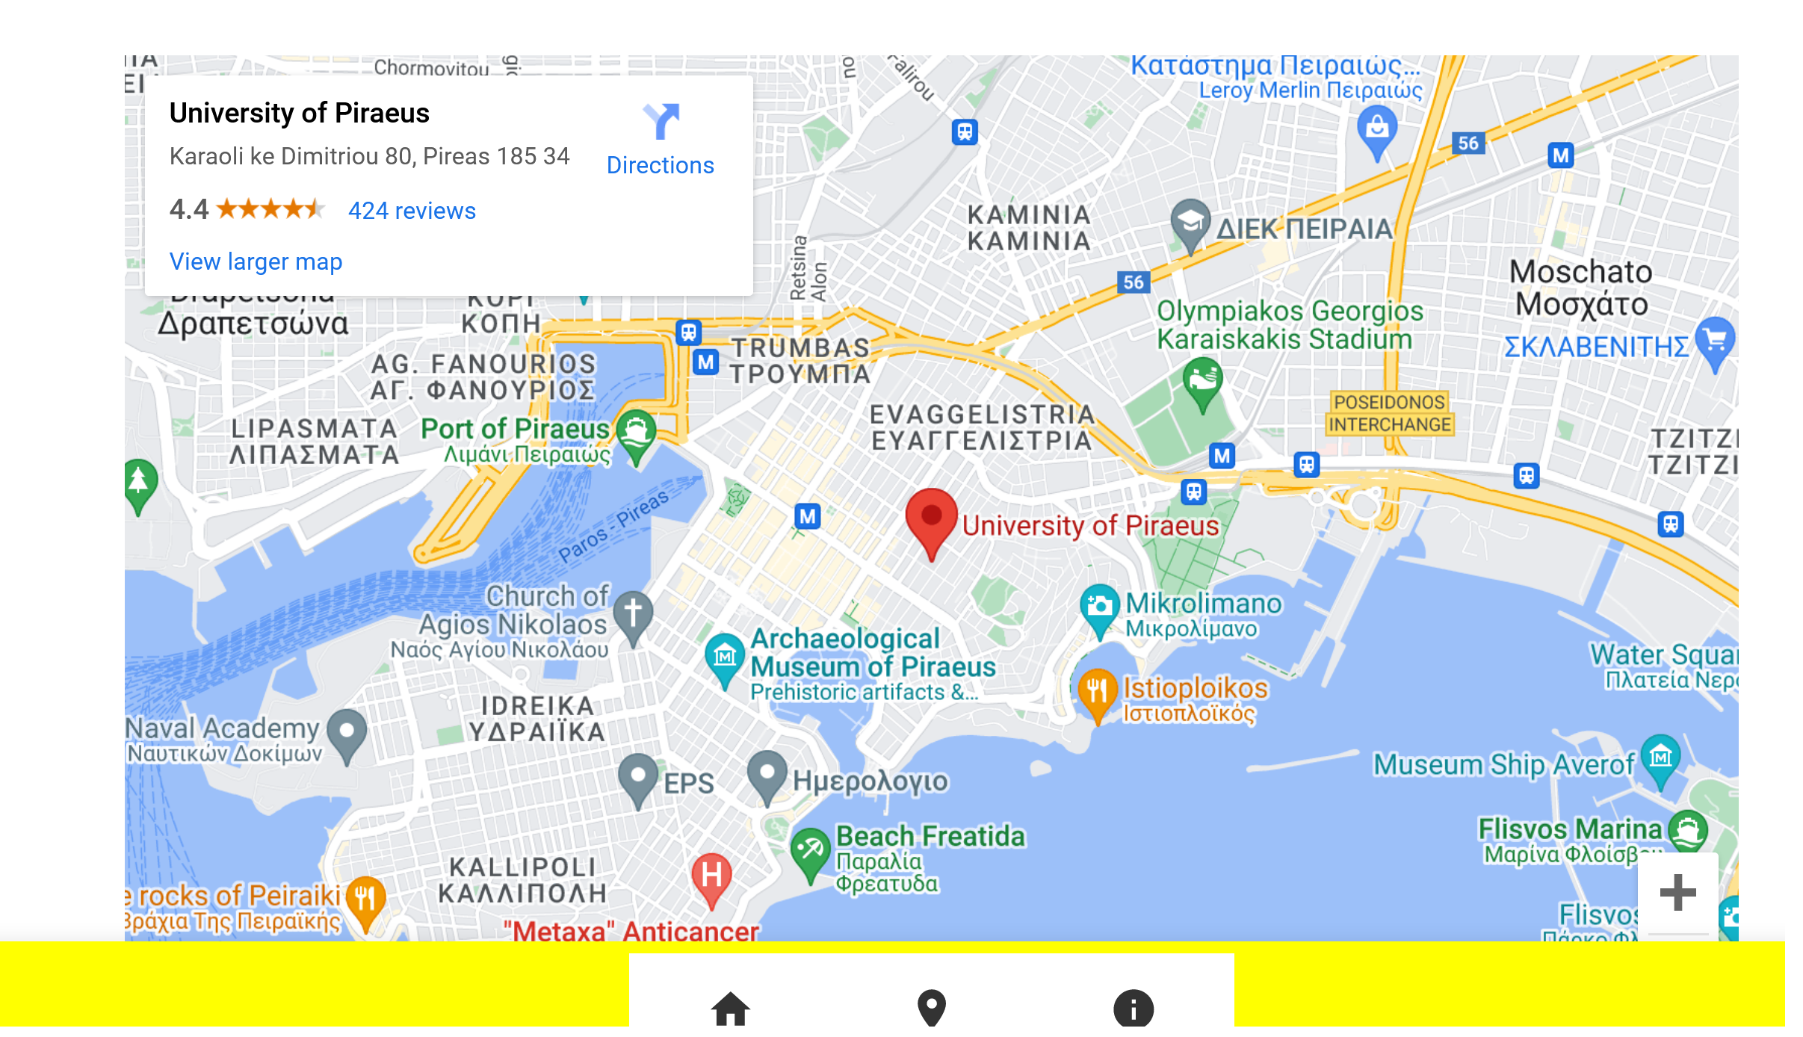
INFO PAGES
LOCATION PAGE

Slide 11
INFO PAGES
INFO PAGE

Slide 12
NAVIGATION THROUGH THE PAGES

Slide 13
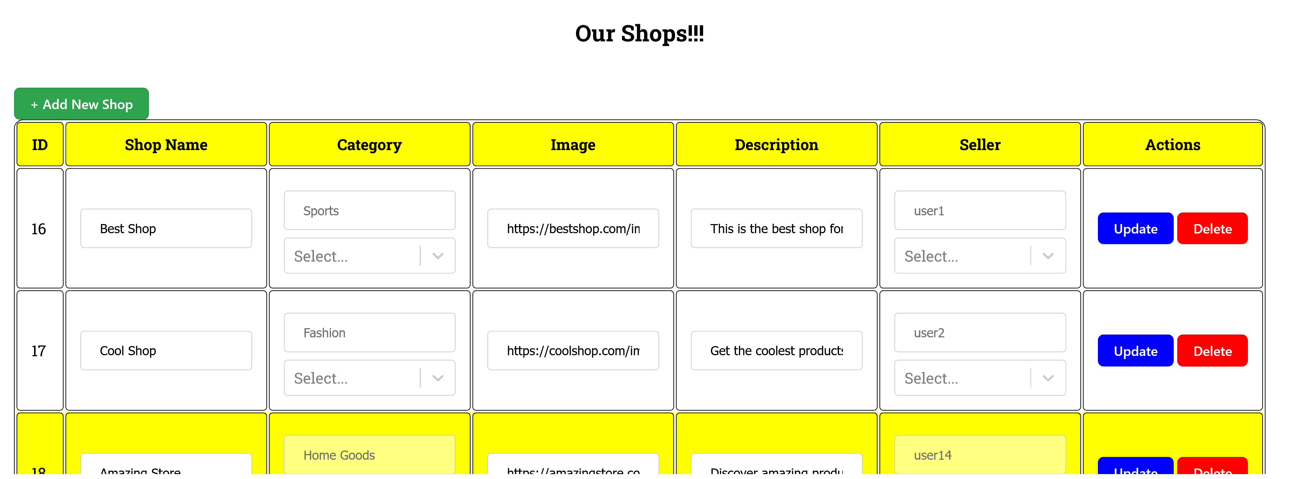
NAVIGATION THROUGH THE PAGES (Access the pages from the Left Menu)
SHOP PAGE

Slide 14
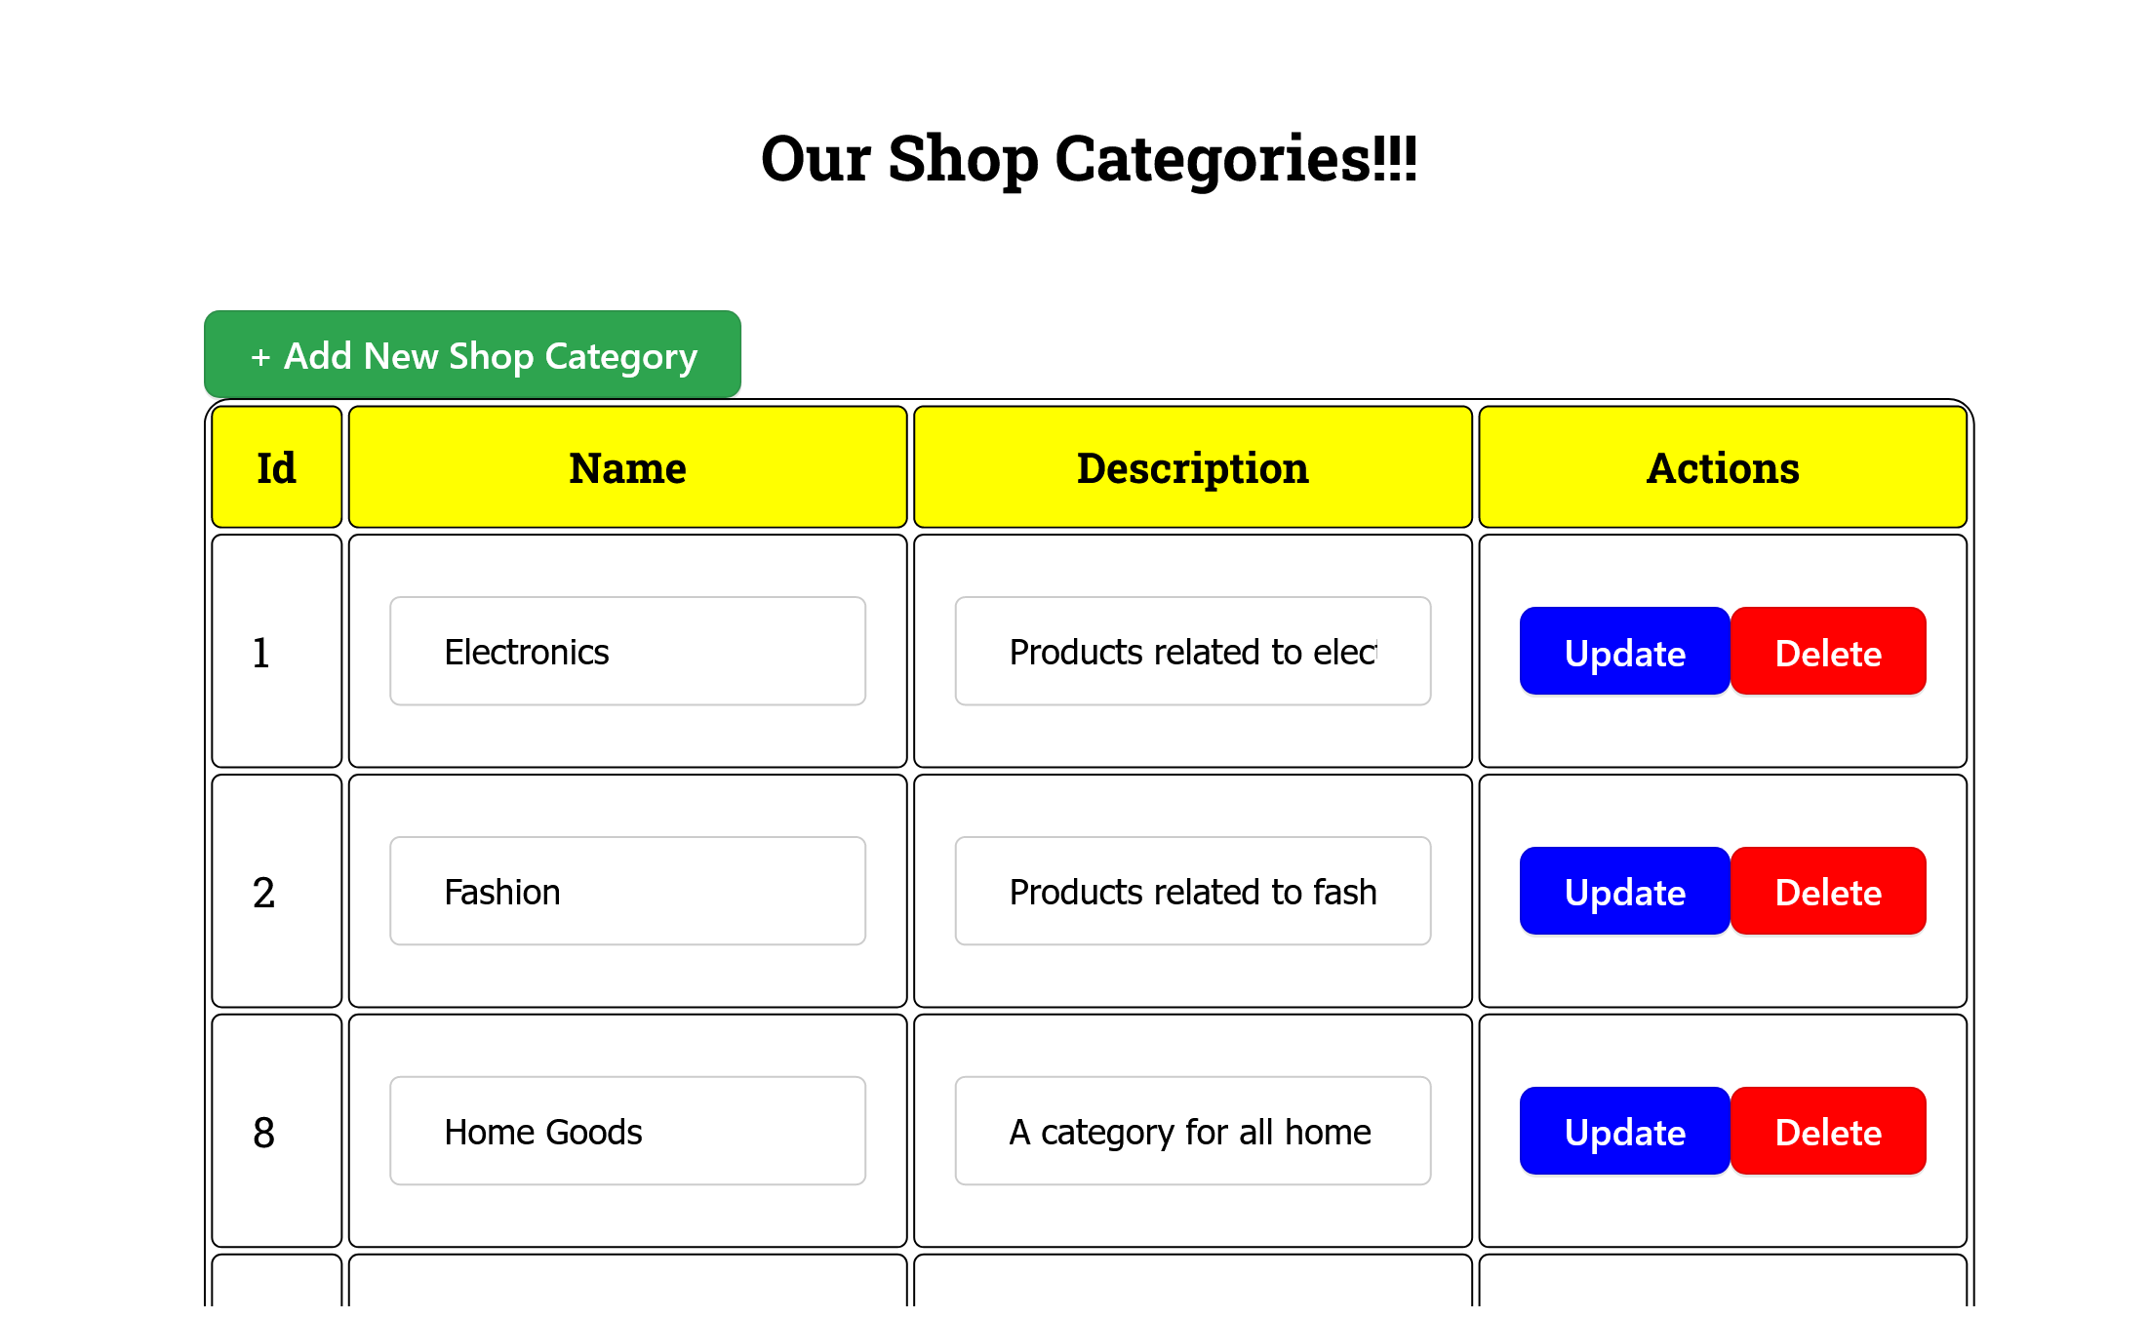
NAVIGATION THROUGH THE PAGES (Access the pages from the Left Menu)
SHOP CATEGORIES PAGE

Slide 15
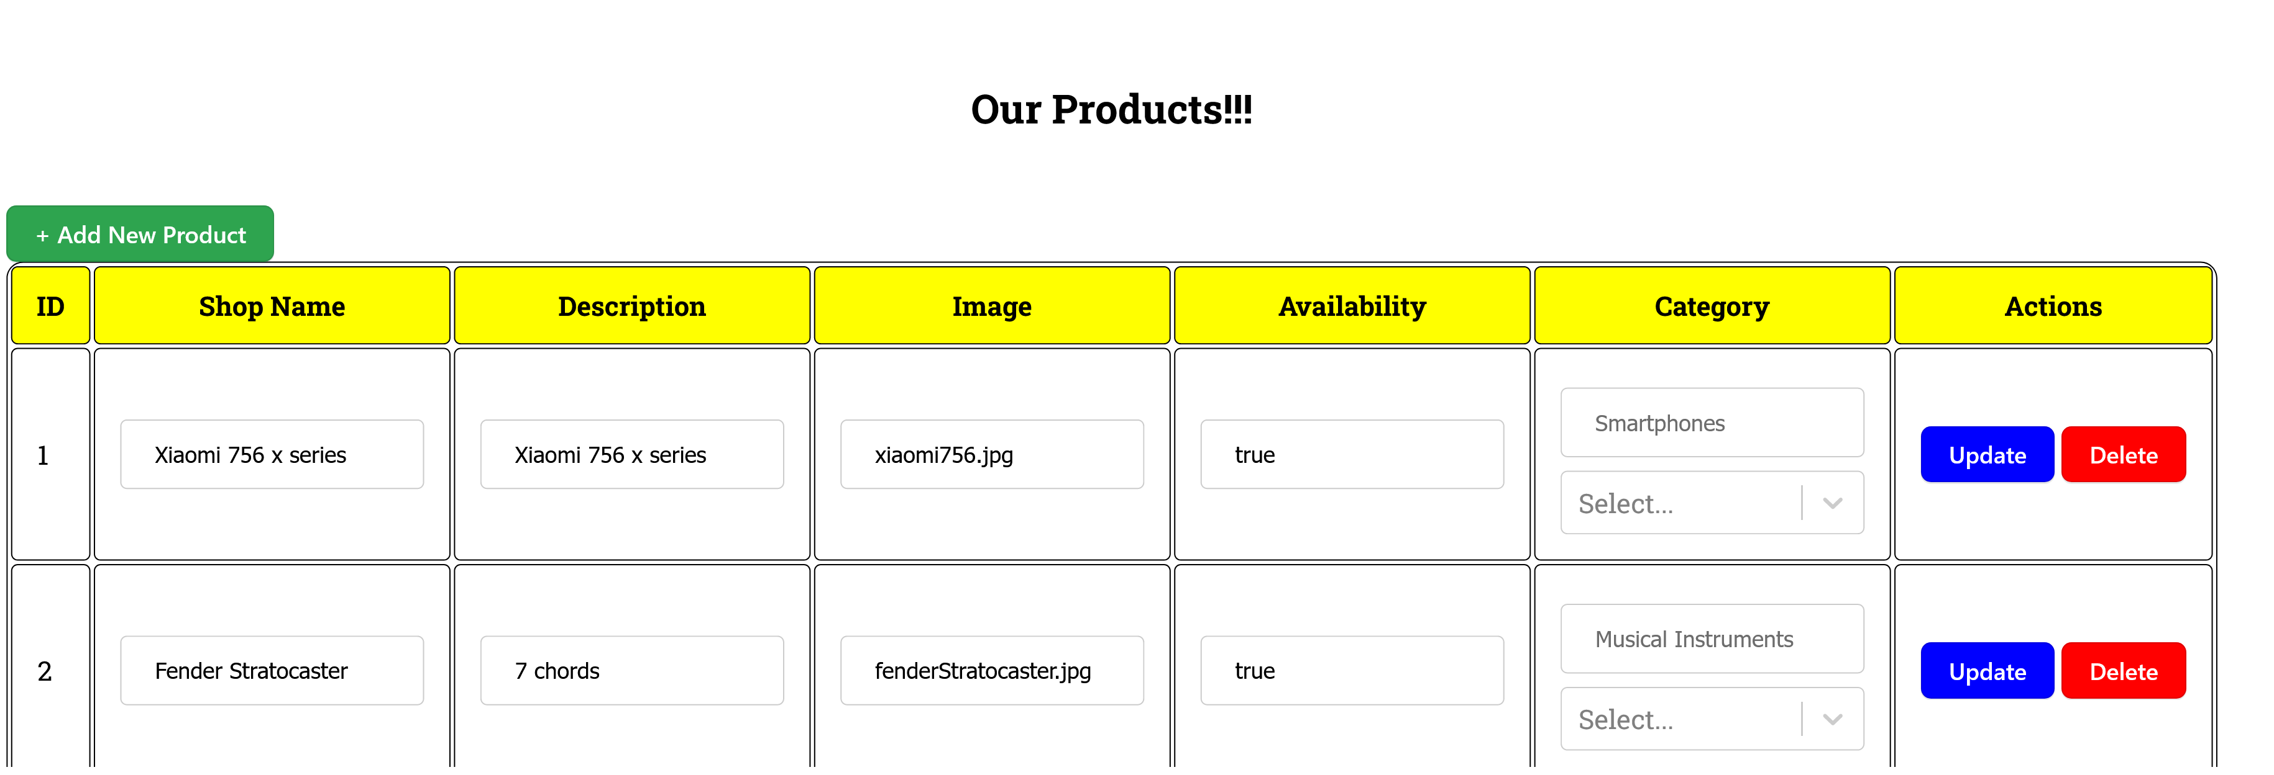
NAVIGATION THROUGH THE PAGES (Access the pages from the Left Menu)
PRODUCT PAGE

Slide 16
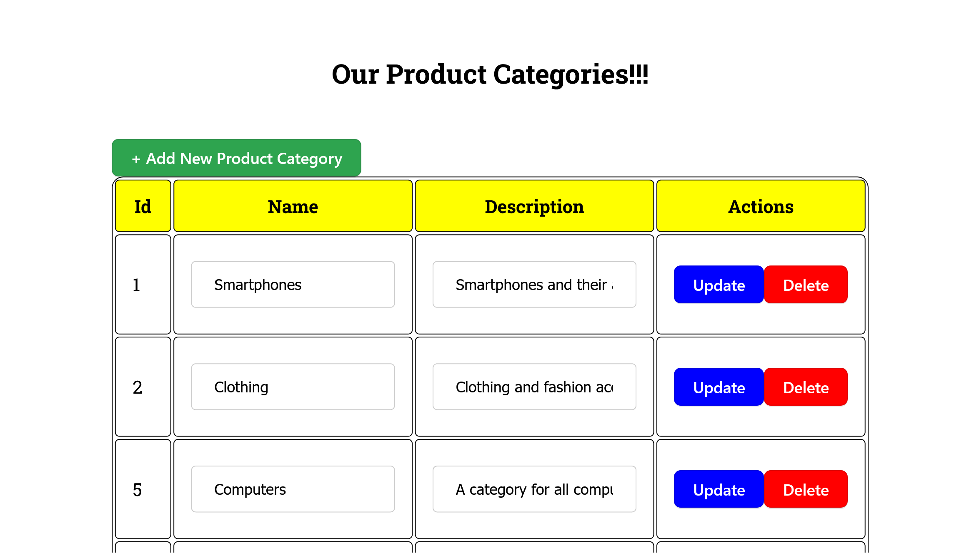
NAVIGATION THROUGH THE PAGES (Access the pages from the Left Menu)
PRODUCT CATEGORIES PAGE

Slide 17
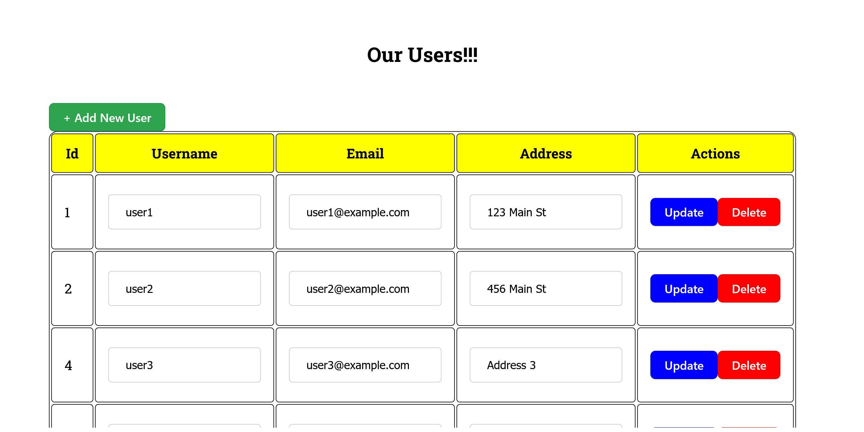
NAVIGATION THROUGH THE PAGES (Access the pages from the Left Menu)
USERS PAGE

Slide 18
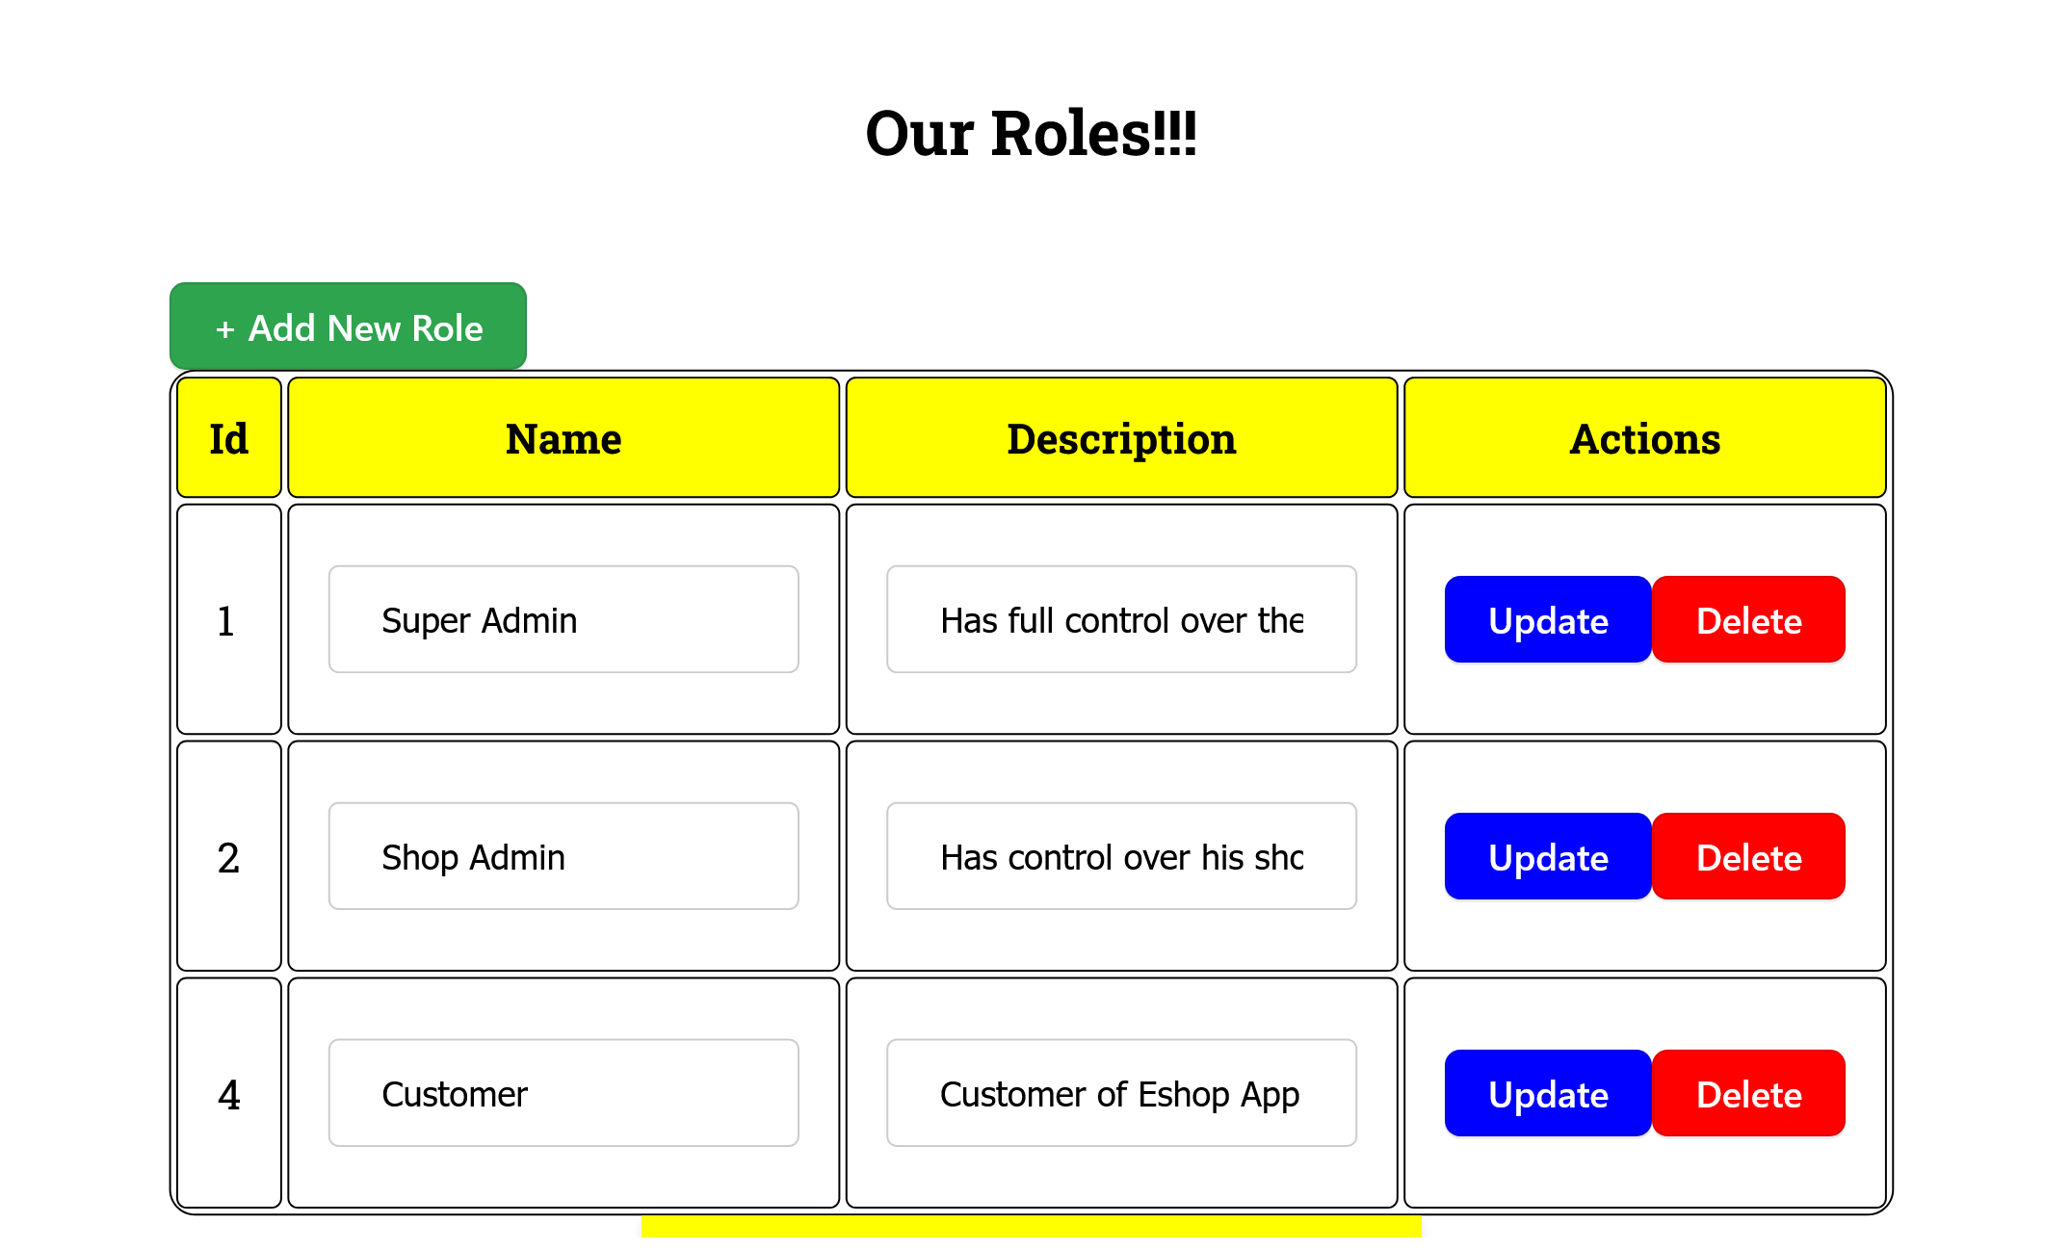
NAVIGATION THROUGH THE PAGES (Access the pages from the Left Menu)
ROLES PAGE

Slide 19
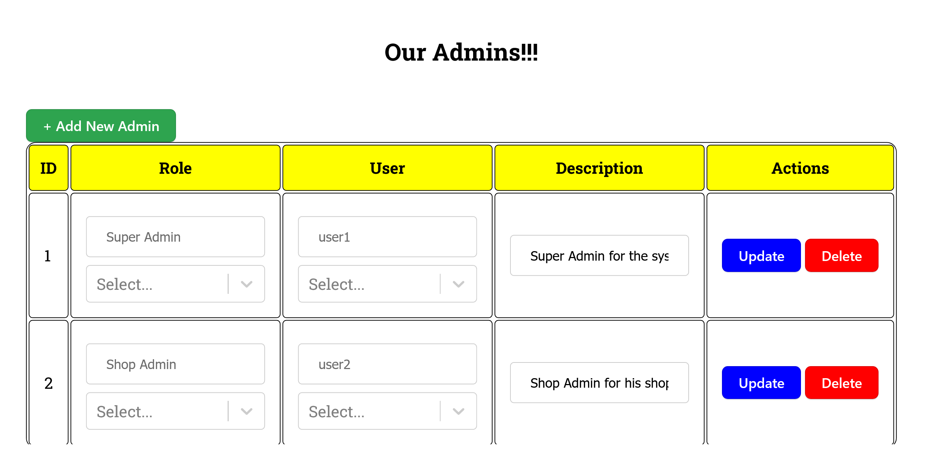
NAVIGATION THROUGH THE PAGES (Access the pages from the Left Menu)
ADMINS PAGE

Slide 20
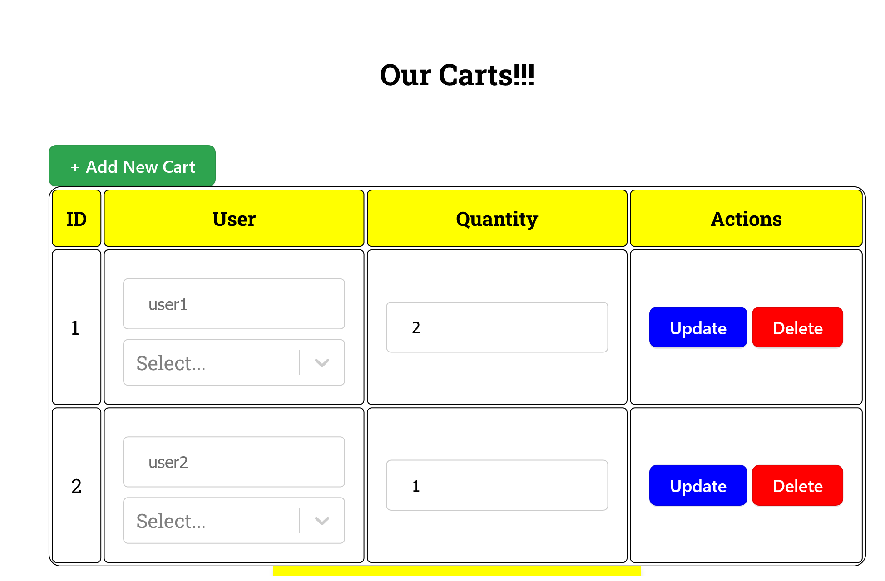
NAVIGATION THROUGH THE PAGES (Access the pages from the Left Menu)
CARTS PAGE

Slide 21
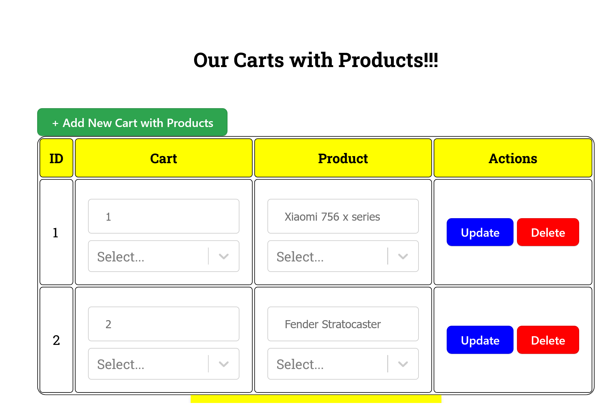
NAVIGATION THROUGH THE PAGES (Access the pages from the Left Menu)
CART AND PRODUCTS PAGE

Slide 22
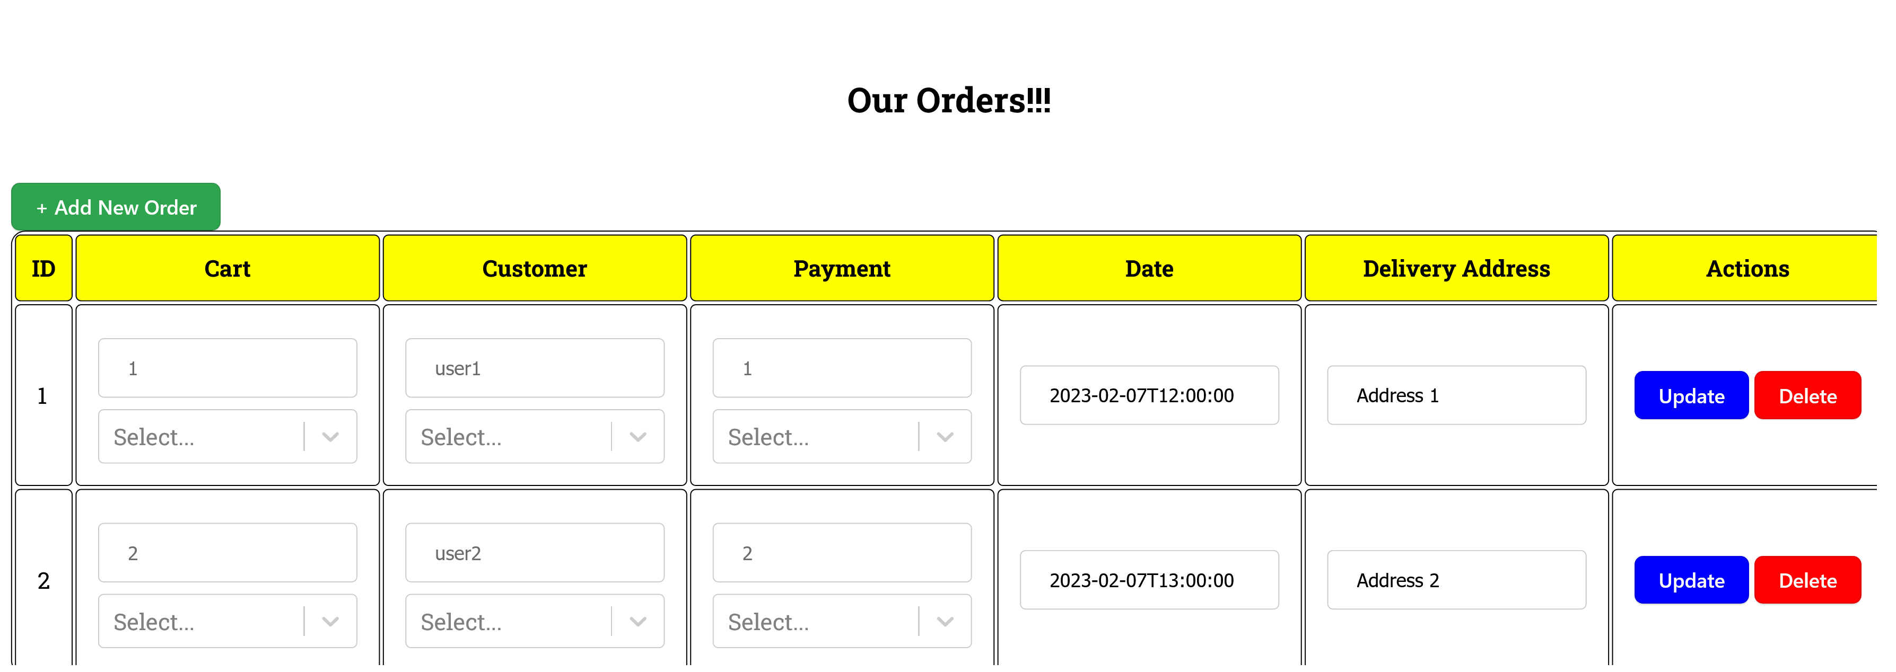
NAVIGATION THROUGH THE PAGES (Access the pages from the Left Menu)
ORDERS PAGE

Slide 23
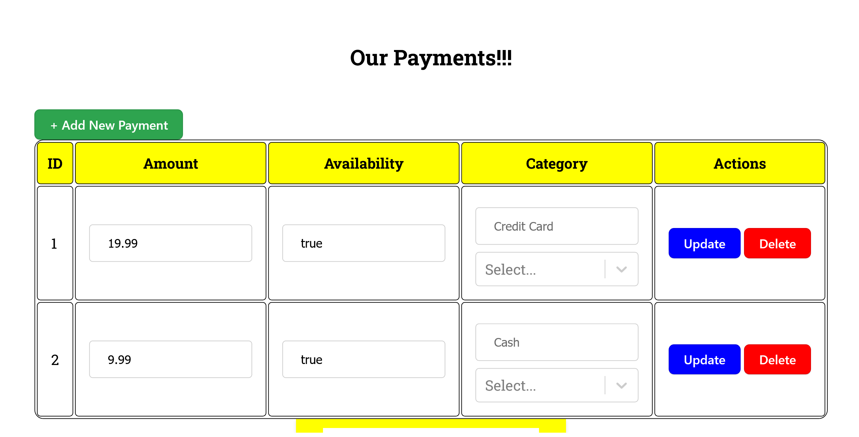
NAVIGATION THROUGH THE PAGES (Access the pages from the Left Menu)
PAYMENT PAGE

Slide 24
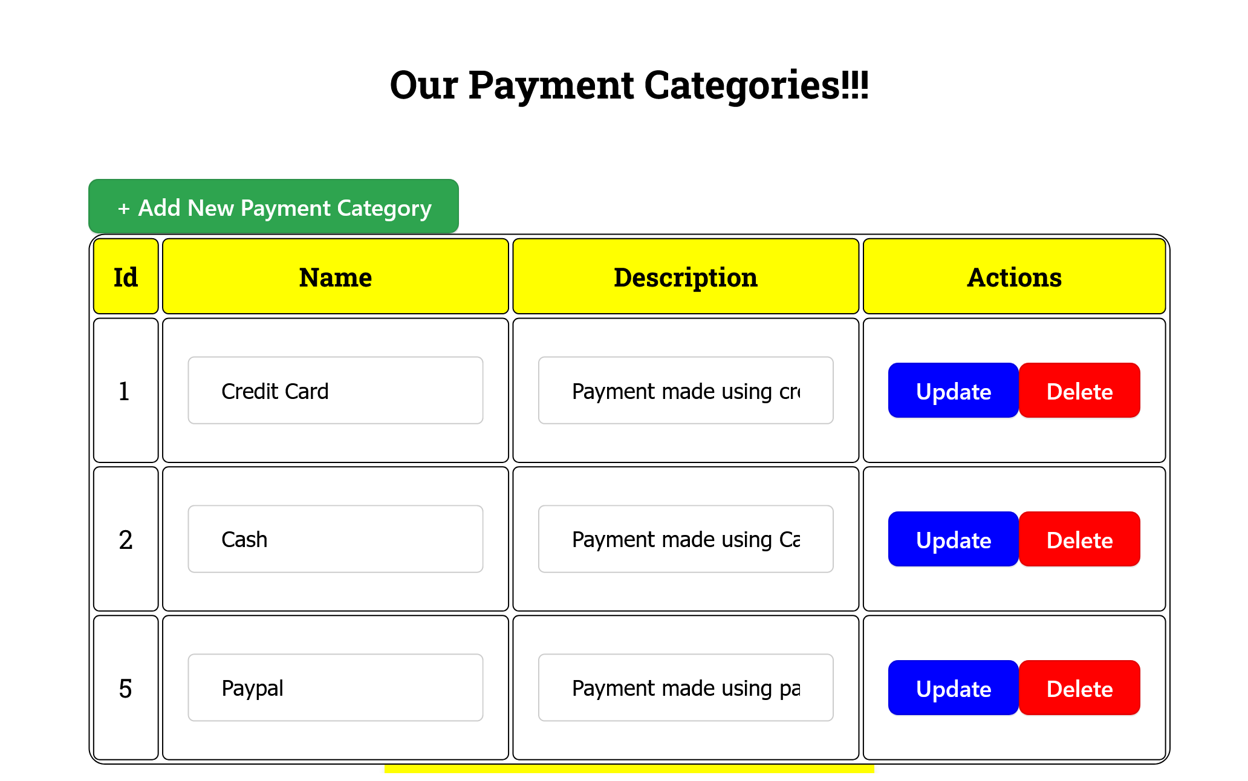
NAVIGATION THROUGH THE PAGES (Access the pages from the Left Menu)
PAYMENT CATEGORIES PAGE

Slide 25
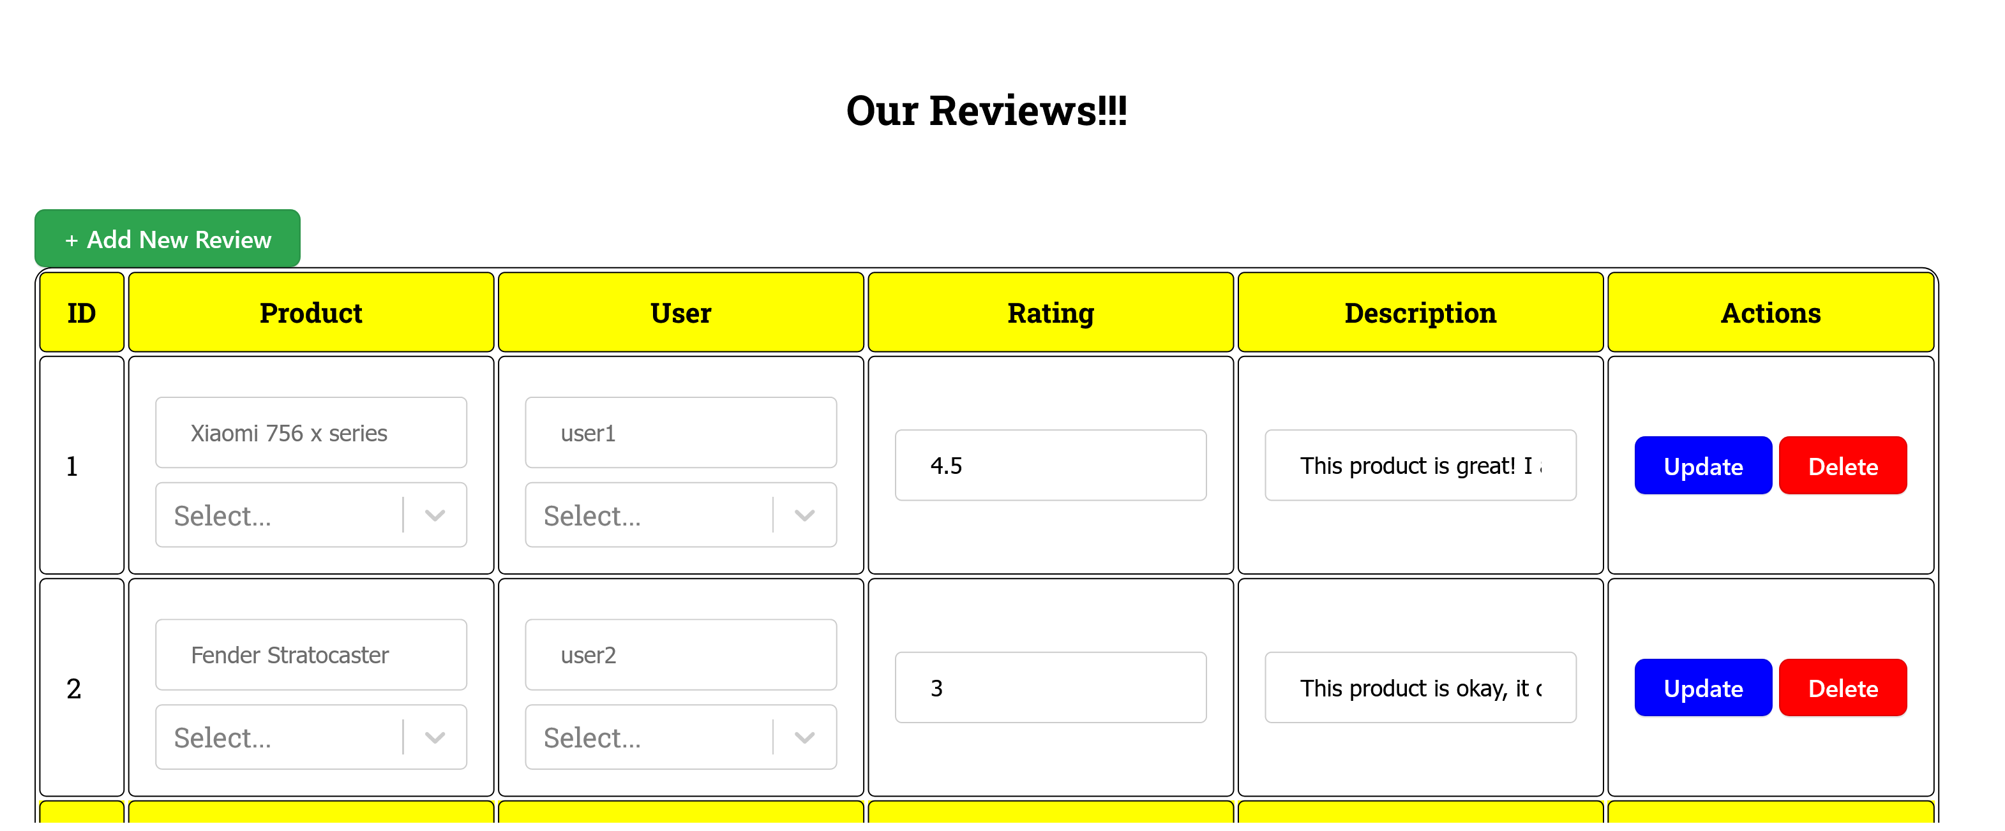
NAVIGATION THROUGH THE PAGES (Access the pages from the Left Menu)
REVIEWS PAGE

Slide 26
AVAILABLE ACTIONS AND HOW TO

Slide 27
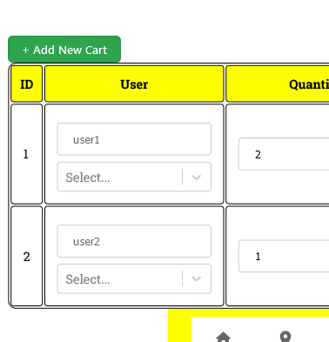
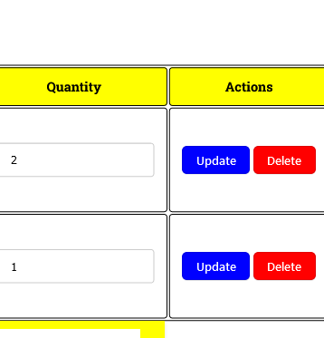
AVAILABLE ACTIONS AND HOW TO
The 3 Main Actions for Every Page!
01
02
03
ADD
UPDATE
DELETE
Add Action via this green button!
Update Action via this blue button
Delete Action via this red button

Slide 28

Thank you for being so patient!
Congratulations!
You Made it till the end!
Not the easiest thing to do!
Have a nice Shopping Time!!!!

